Slide 1


Campus Resource Exchange Network for Academic Resource Sharing
CSA4305 –Internet Programming
Supervisor-
Dr.D.Sudhagar
Presented by-
Deepak V-192411021
Aaron Samuel S- 19411022
Y. Abhay-192411219
Meghanadh A-1923722281

Slide 2
Introduction
Enables secure exchange of campus academic resources.
Supports buying, selling, lending, donating, and swapping.
Reduces student expenses through resource reuse.
Promotes sustainable and affordable campus resource sharing.
Ensures trusted transactions using QR verification.

Slide 3
Problem statement
Students repeatedly purchase costly academic resources.
Unused materials remain wasted after every semester.
Existing platforms lack campus-specific exchange features.
Finding trustworthy student sellers is difficult.
No centralized academic resource exchange platform.

Slide 4
Objective
Develop secure campus resource exchange platform.
Simplify academic resource buying and sharing.
Reduce educational expenses through resource reuse.
Ensure trusted exchanges using QR verification.
Promote sustainability among college students.

Slide 5
METhodology
MODULE 1: User Authentication & Profile Management
Register students using verified college email.
Provide secure login and password protection.
Manage student profiles and account details.
Enable password recovery through email verification.
Maintain secure user roles and permissions.

Slide 6
METhodology
MODULE 2: Resource Listing & Marketplace
Upload academic resources with complete details.
Search resources using smart filtering options.
Buy, sell, lend, donate, or exchange.
Display pricing, condition, and seller information.
Manage listings with easy editing options.

Slide 7
METhodology
MODULE 3:Exchange Management & Trust System
Generate QR codes for secure verification.
Process exchange requests between students securely.
Calculate trust scores using transaction history.
Store complete exchange and transaction records.
Collect ratings and reviews after exchanges.

Slide 8
METhodology
MODULE 4:Chat, Notifications & Feedback Management
Enable secure messaging between buyers and sellers.
Send instant notifications for exchange requests and updates.
Allow students to rate completed exchange transactions.
Collect user feedback to improve platform reliability.
Maintain communication history for future reference.

Slide 9
Tools Used
Frontend: HTML5, CSS3, JavaScript, Bootstrap
Backend: PHP
Database: MySQL
Web Server: XAMPP (Apache)
Code Editor: Visual Studio Code
QR Code Library: PHP QR Code
Browser: Google Chrome

Slide 11
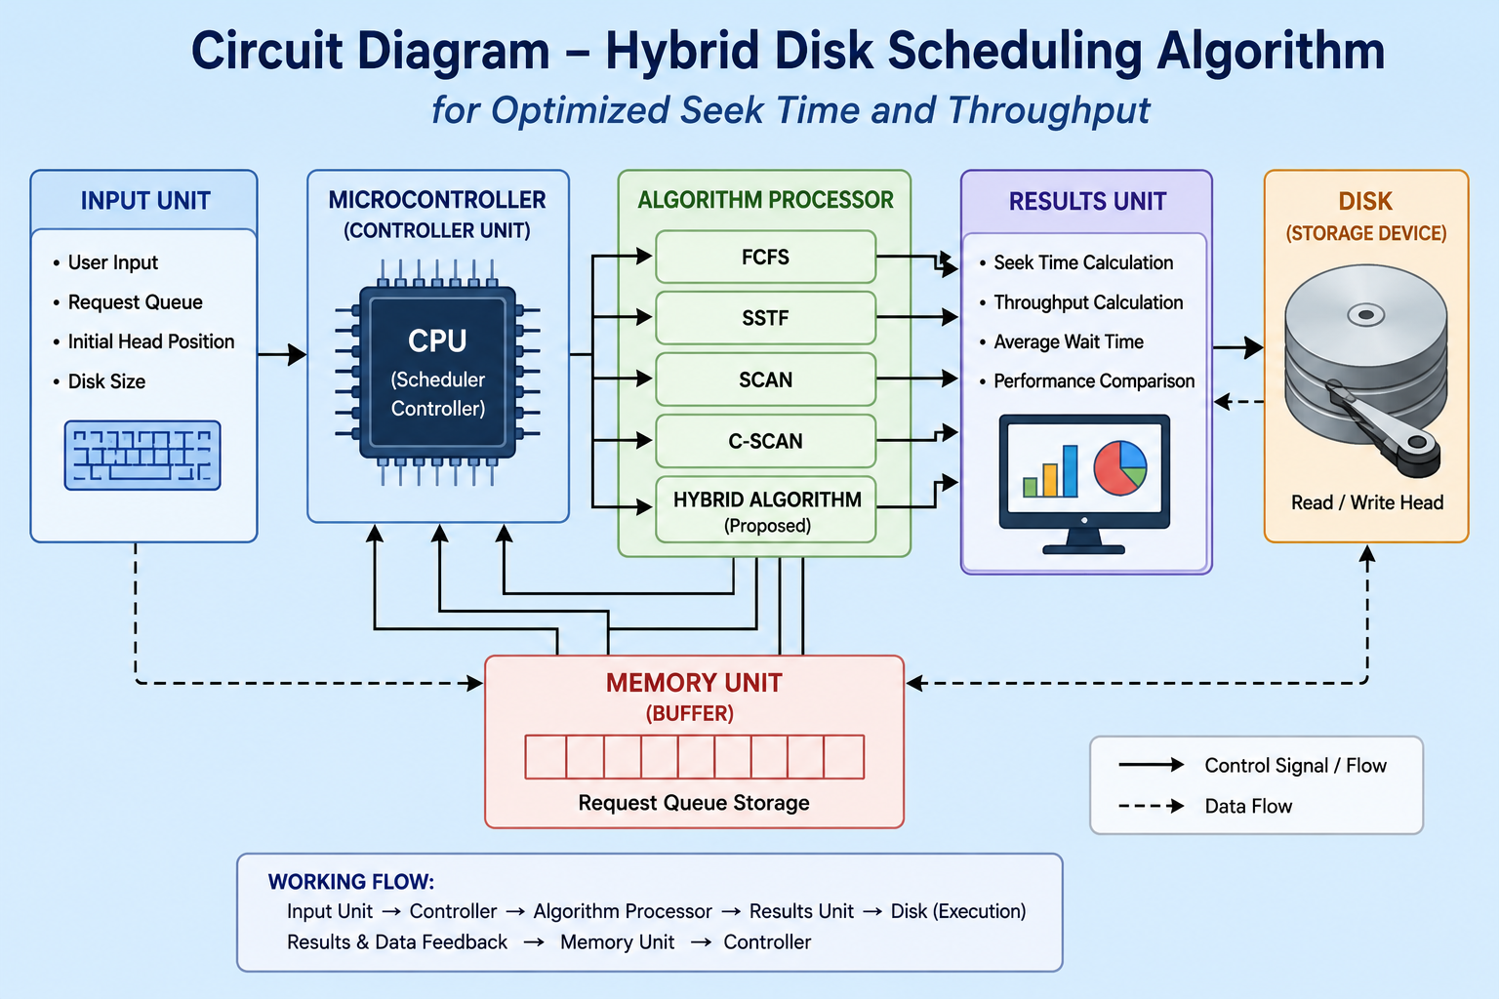

Slide 12
Literature survey
Year | Paper Title | Contribution
2026 | Leveraging I/O Stalls for Efficient Scheduling in ANNS | Improved throughput by utilizing idle I/O stall periods while maintaining latency constraints.
2025 | An Optimized Disk Scheduling Algorithm with Bad-Sector Management | Reduced seek time, and power consumption while handling bad sectors efficiently.
2024 | Proposing Disk Scheduling Algorithm to Enhance the Efficiency of Disk Performance | Improved disk performance by minimizing seek time, head movement, and transfer delay.
2024 | Optimized Universal Disk Scheduling Algorithm | Proposed a optimization model to reduce seek time and improve disk performance across workloads.

Slide 13
Results
Successfully implemented FCFS, SSTF, SCAN, and C-SCAN disk scheduling algorithms.
Disk request queue and head movement simulation were executed correctly.
Seek time calculation for traditional algorithms was completed successfully.
Initial hybrid scheduling logic was developed and tested with sample inputs.
Comparative performance analysis setup was prepared for final evaluation phase.

Slide 14
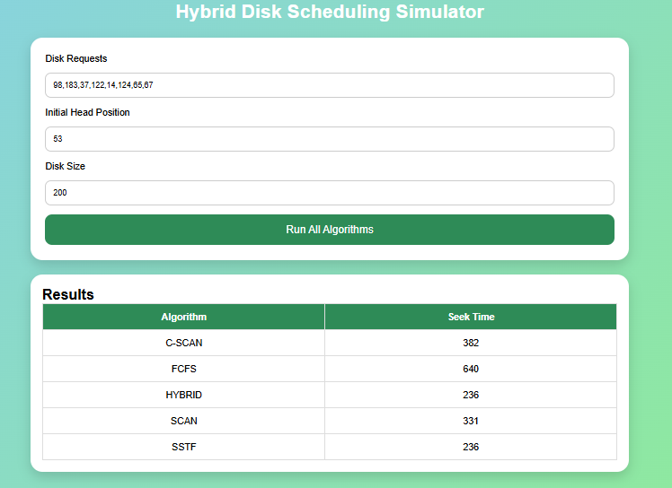

Slide 15
Conclusion
The project implemented multiple disk scheduling algorithms for performance analysis.
Traditional algorithms were compared based on seek time and throughput efficiency.
The proposed hybrid disk scheduling approach reduced unnecessary disk head movement.
Performance analysis showed improved efficiency compared to conventional methods.
The project demonstrated how optimized scheduling can enhance overall operating system performance.

Slide 16
Future scope
The hybrid algorithm can be enhanced using Artificial Intelligence techniques for smarter scheduling decisions.
The system can be extended to support real-time operating system environments.
Cloud and distributed storage scheduling techniques can be integrated in future versions.
Advanced visualization dashboards can be added for real-time performance monitoring.
The project can be optimized further for SSDs and modern high-speed storage devices.

Slide 17
References
Zhao, Y., Li, Q., & Wang, H. (2026). Leveraging I/O Stalls for Efficient Scheduling in ANNS.
Patil, S. B., & Patil, R. M. (2025). An Optimized Disk Scheduling Algorithm with Bad-Sector Management.
Pradeep, T., & Manoj, B. S. (2024). Proposing Disk Scheduling Algorithm to Enhance the Efficiency of Disk Performance.
Hannan, M. A., & Hussain, A. (2024). Optimized Universal Disk Scheduling Algorithm.
M. Bouška, P. Šůcha, A. Novák, and Z. Hanzálek, “Deep Learning-Driven Scheduling Algorithm for a Single Machine Problem Minimizing the Total Tardiness,” 2024.

